Slide 1
§5 Мінімізація булевих функцій

Slide 2
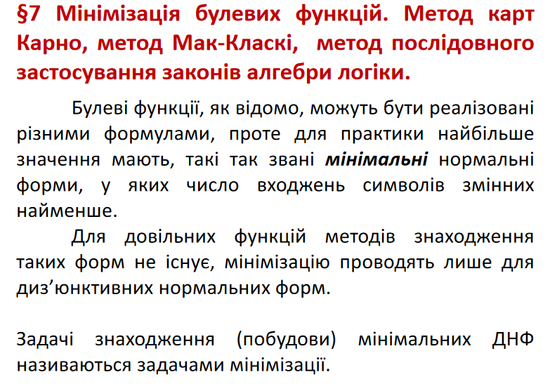

Slide 3
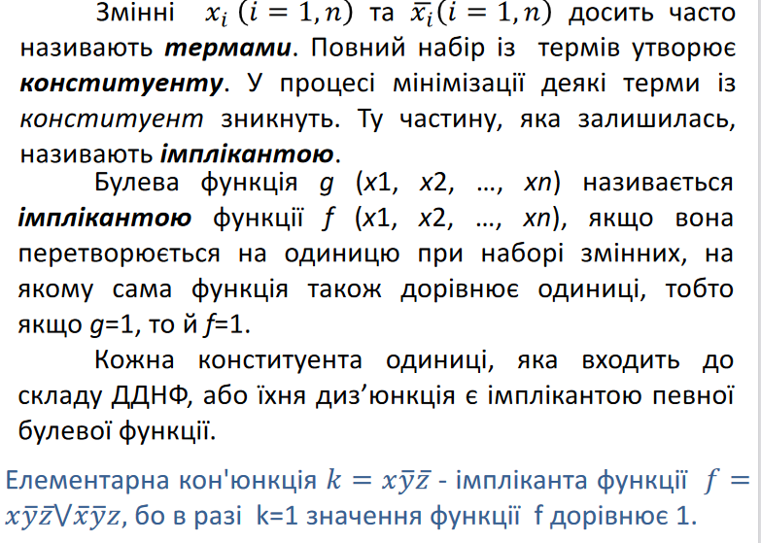

Slide 4
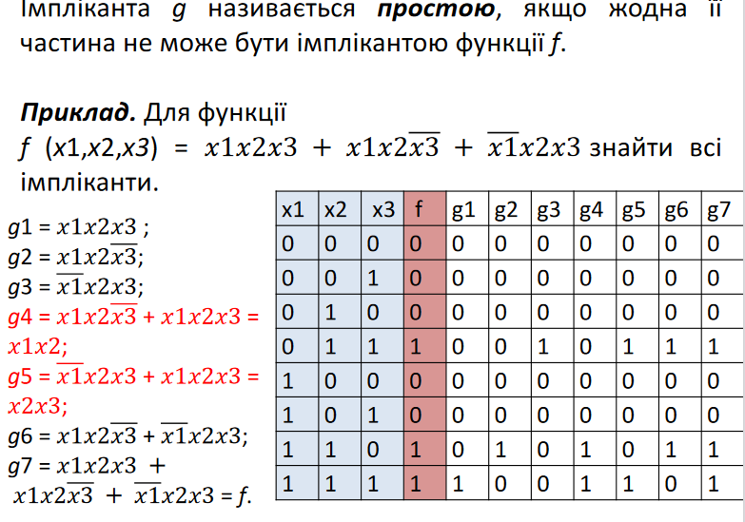

Slide 5
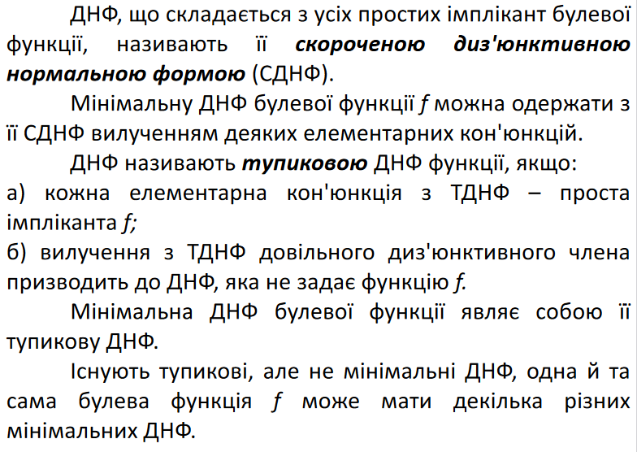

Slide 6
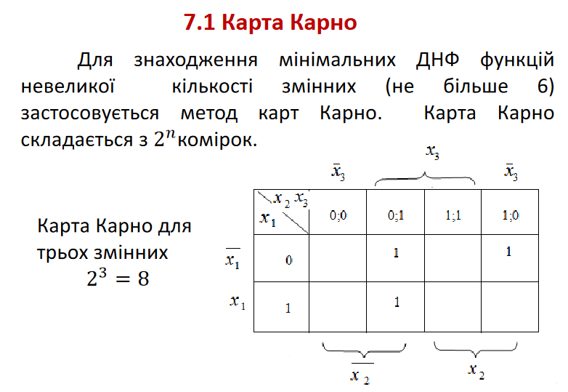

Slide 7
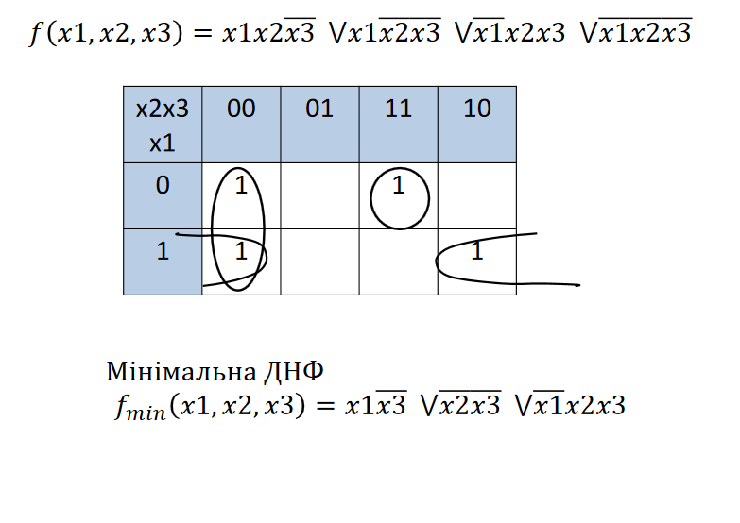

Slide 8
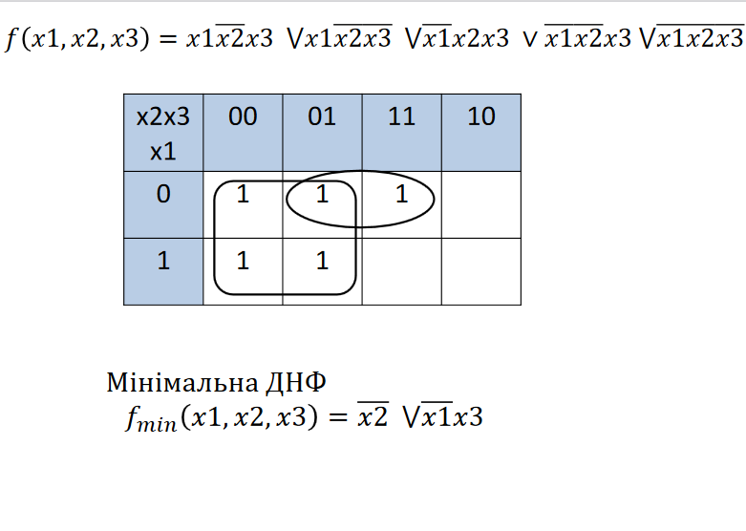

Slide 9
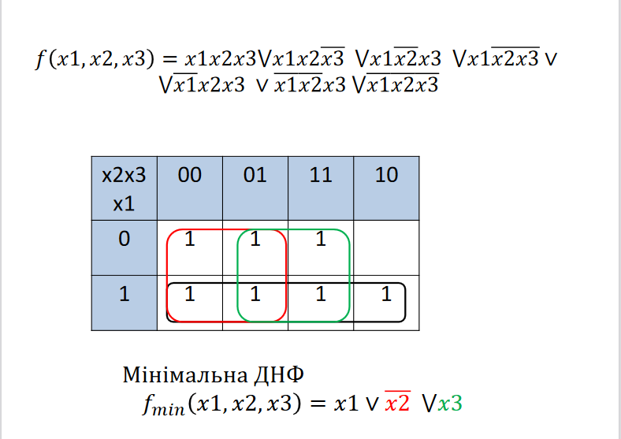

Slide 10
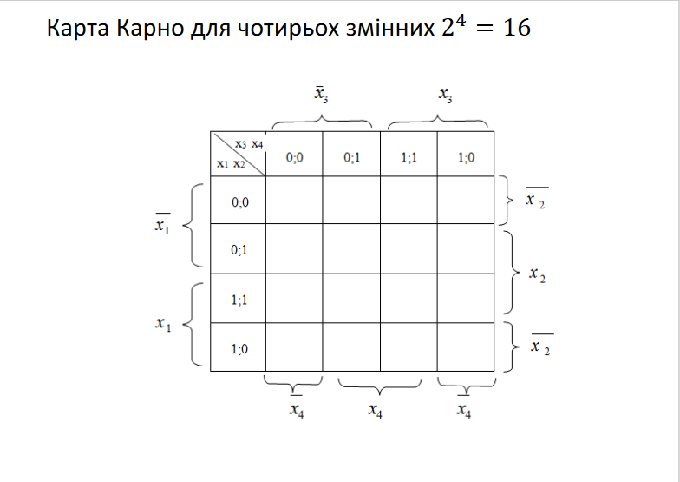

Slide 11
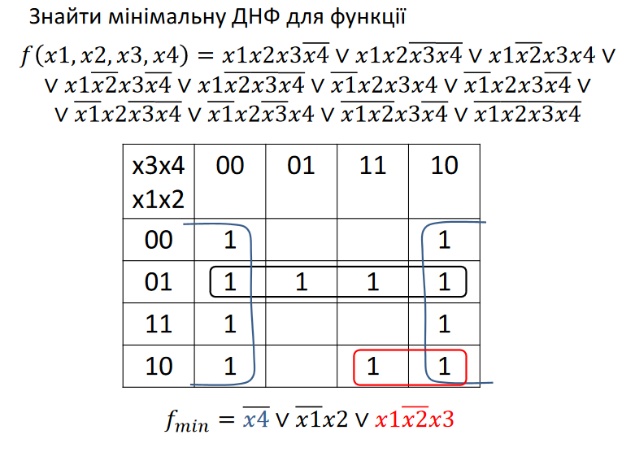

Slide 12
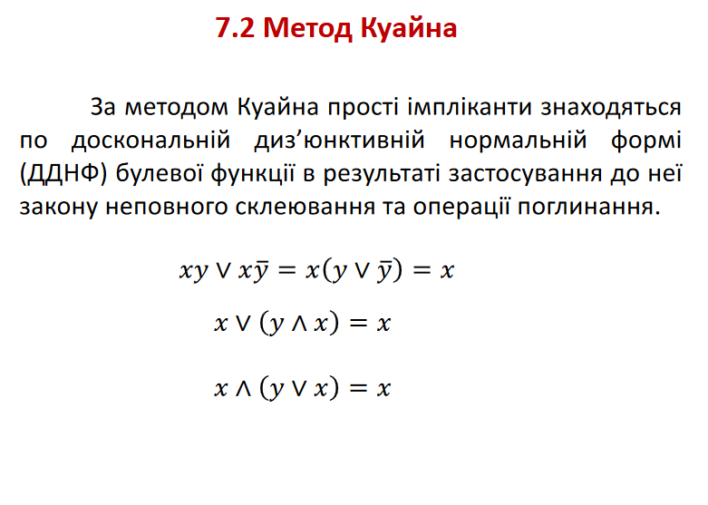

Slide 13
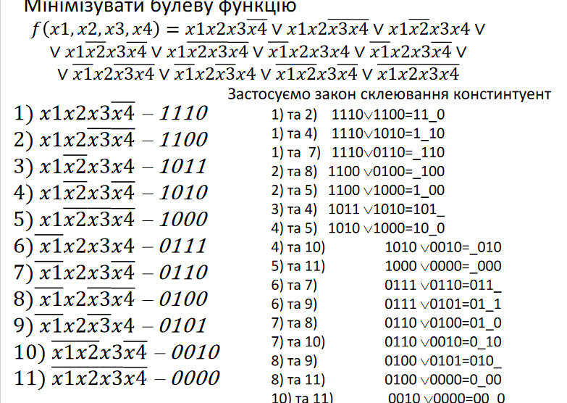

Slide 14
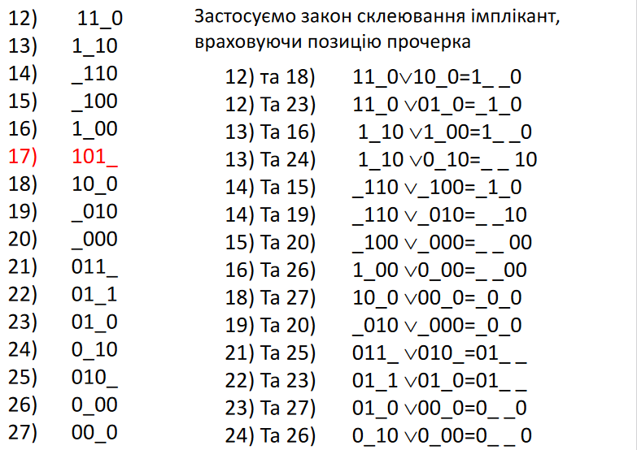

Slide 15
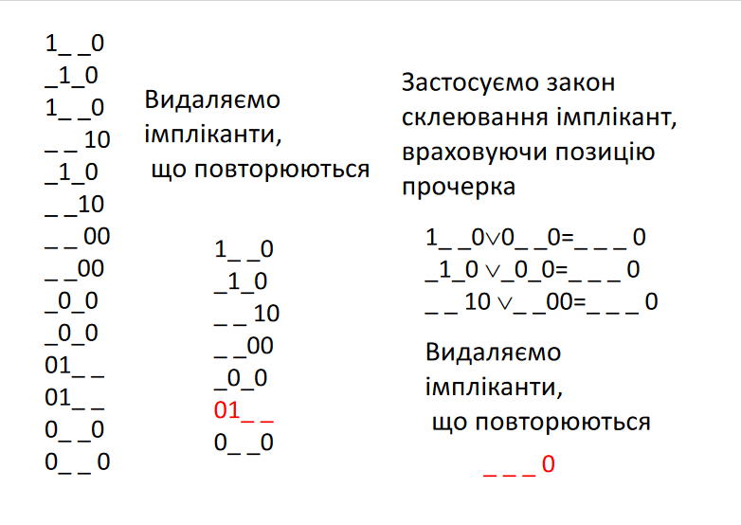

Slide 16
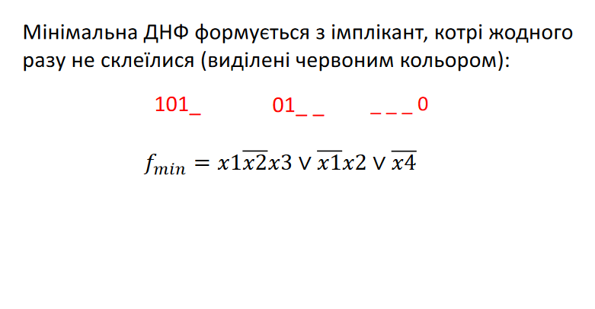

Slide 17
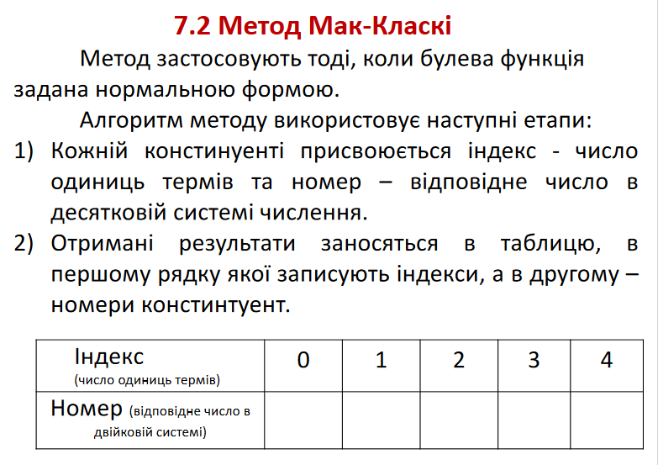

Slide 18
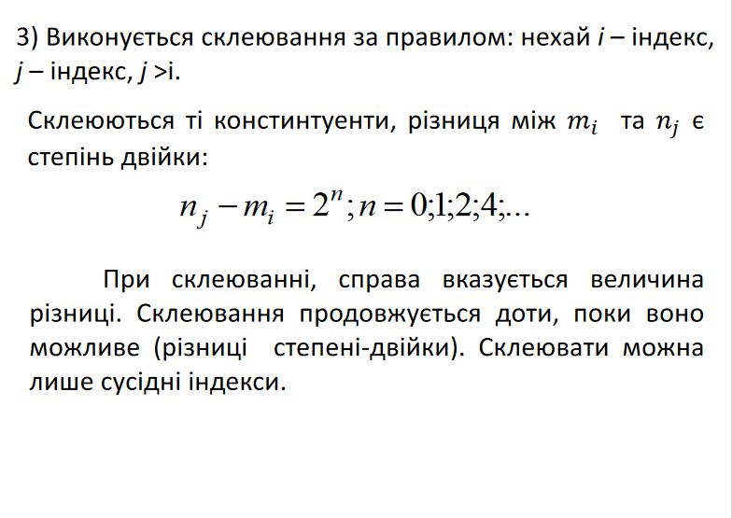

Slide 19
X1 | X2 | X3 | X4 | Десяткове число
0 | 0 | 0 | 0 | 0
0 | 0 | 0 | 1 | 1
0 | 0 | 1 | 0 | 2
0 | 0 | 1 | 1 | 3
0 | 1 | 0 | 0 | 4
0 | 1 | 0 | 1 | 5
0 | 1 | 1 | 0 | 6
0 | 1 | 1 | 1 | 7
1 | 0 | 0 | 0 | 8
1 | 0 | 0 | 1 | 9
1 | 0 | 1 | 0 | 10
1 | 0 | 1 | 1 | 11
1 | 1 | 0 | 0 | 12
1 | 1 | 0 | 1 | 13
1 | 1 | 1 | 0 | 14
1 | 1 | 1 | 1 | 15

Slide 20
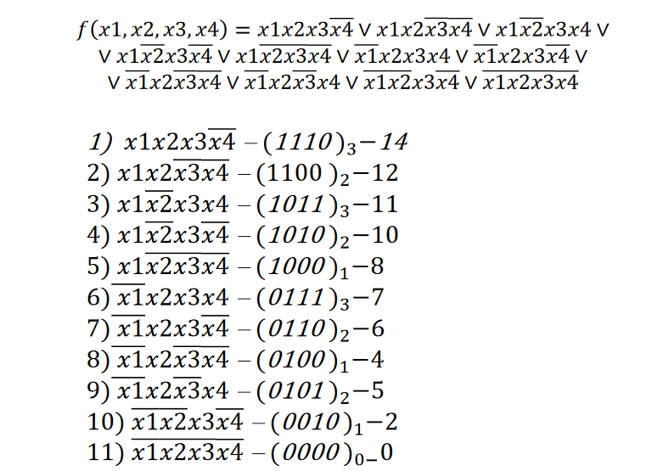

Slide 21
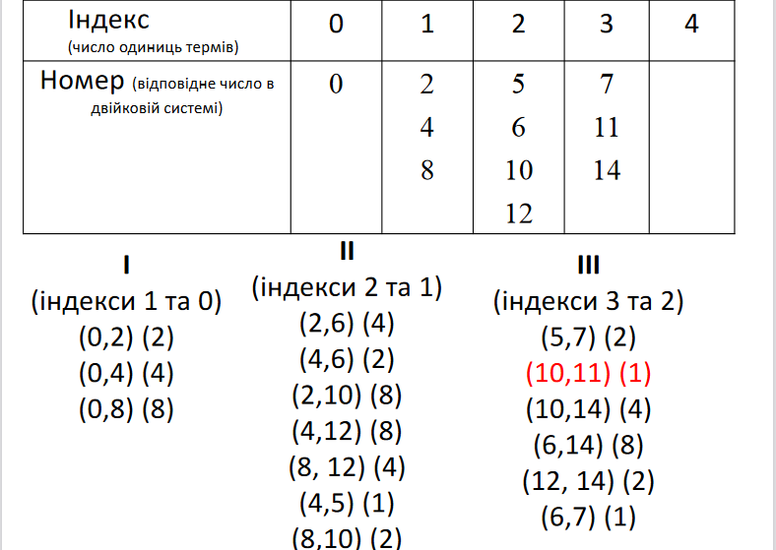

Slide 22
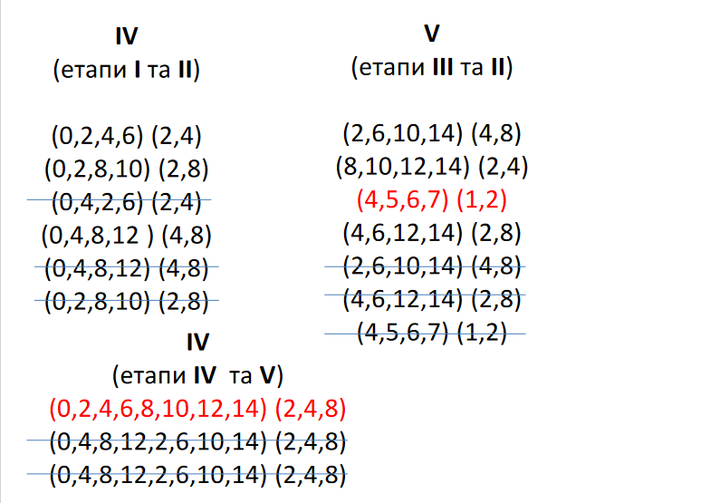

Slide 23
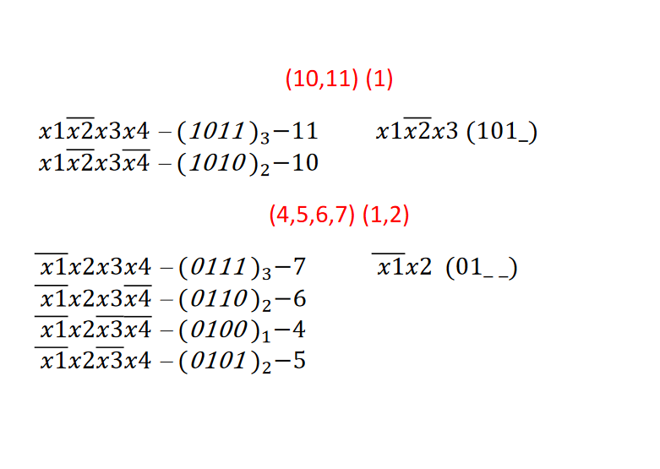

Slide 24
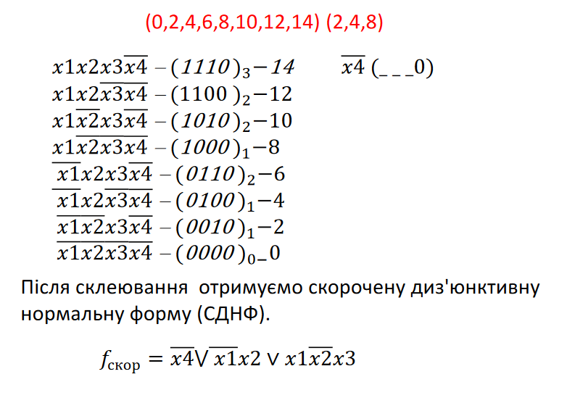

Slide 25
