Slide 1
Programming Parallel Hardware using MPJ Express
By A. Shafi

Slide 2
Why Java?
Portability
A popular language in colleges and software industry:
Large pool of software developers
A useful educational tool
Higher programming abstractions including OO features
Improved compile and runtime checking of the code
Automatic garbage collection
Support for multithreading
Rich collection of support libraries

Slide 3
MPJ Express
MPJ Express is an MPI-like library that supports execution of parallel Java applications
Three existing approaches to Java messaging:
Pure Java (Sockets based)
Java Native Interface (JNI)
Remote Method Invocation (RMI)
Motivation for a new Java messaging system:
Maintain compatibility with Java threads by providing thread-safety
Handle contradicting issues of high-performance and portability
Requires no change to the native standard JVM

Slide 4
MPJ Express configuration

Slide 5
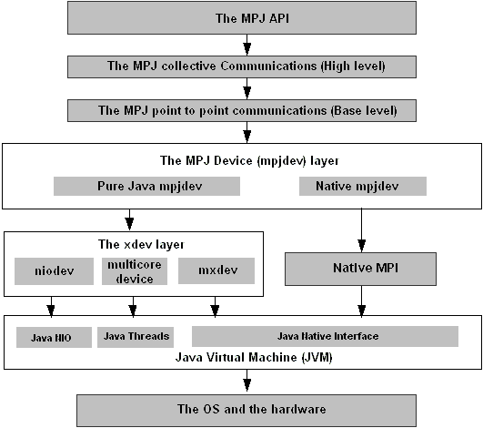
MPJ Express Design

Slide 6
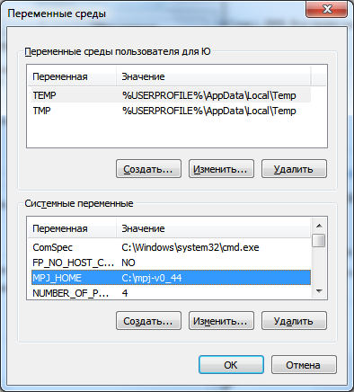
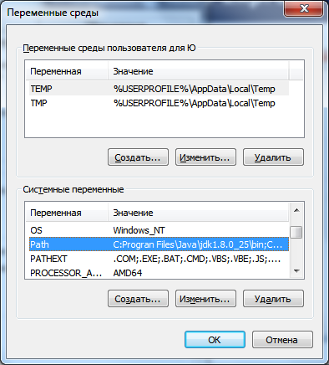
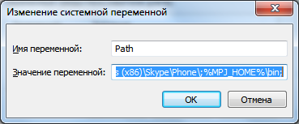
Installing MPJ Express

Slide 7
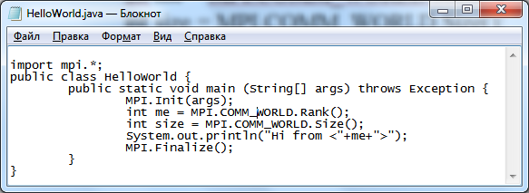
HelloWorld program

Slide 8
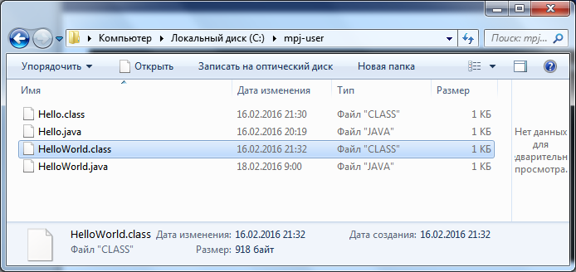
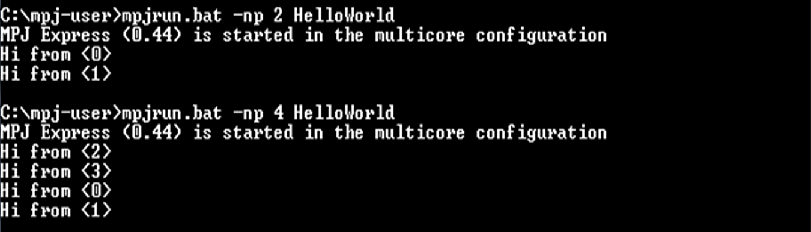
HelloWorld program

Slide 9
An Embarrassingly Parallel Toy Example
Master Process
Worker 0
Worker 1
Worker 2
Worker 3

Slide 10
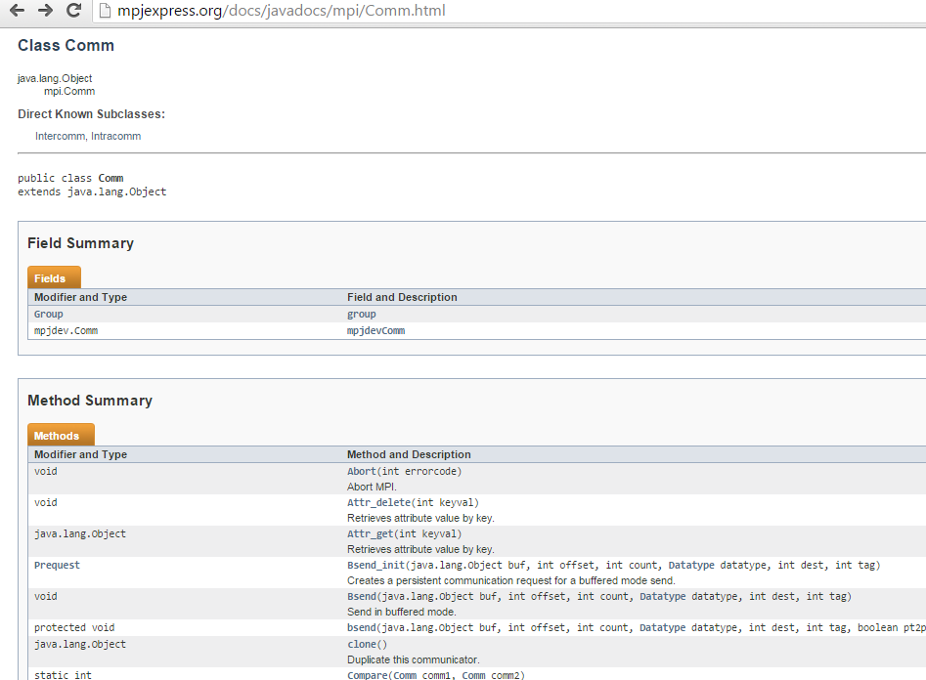
Documentation: class Comm

Slide 11
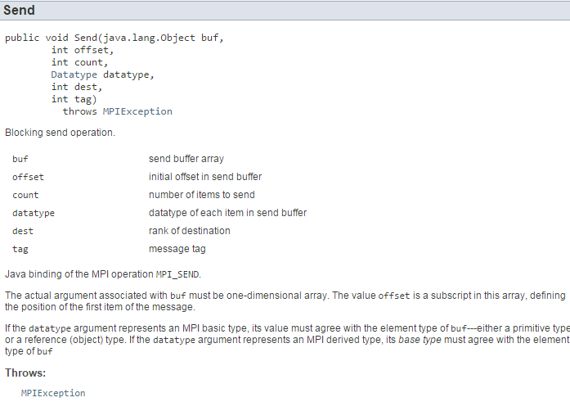
Documentation: Send() method

Slide 12
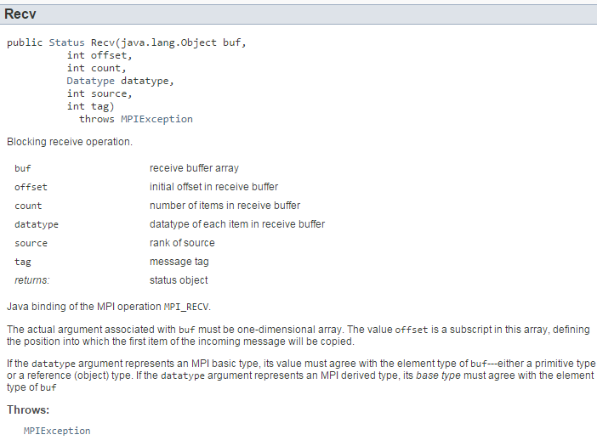
Documentation: Recv() method

Slide 13
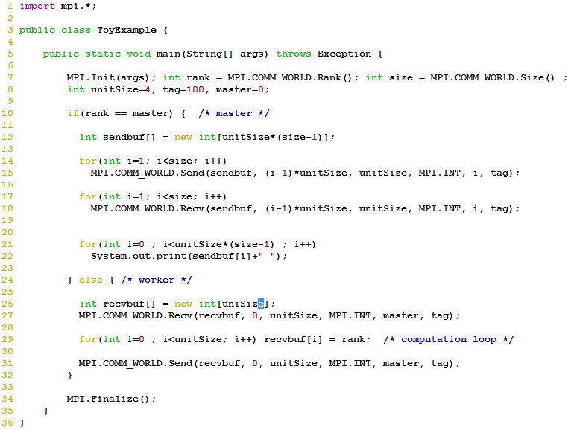
aamirshafi@velour:~/work/mpj-user$ mpjrun.sh -np 5 ToyExample
MPJ Express (0.38) is started in the multicore configuration
1 1 1 1 2 2 2 2 3 3 3 3 4 4 4 4

Slide 14
Point-to-point Communication
 | Standard | Synchronous | Ready | Buffered
Blocking | Send() Recv() | Ssend() | Rsend() | Bsend()
Non-blocking | Isend() Irecv() | Issend() | Irsend() | Ibsend()
Non-blocking methods return a Request object:
Wait() //waits until communication completes
Test() //test if the communication has finished

Slide 15
“Blocking”
Sender
Receiver
Send()
Recv()
CPU waits
CPU waits
time
“Non Blocking”
Sender
Receiver
Isend()
Irecv()
CPU does
computation
CPU does
computation
time
Wait()
Wait()
CPU waits
CPU waits

Slide 16
Thread-safe Communication
Thread-safe MPI libraries allow communication from multiple user threads inside a single process
Such an implementation requires fine-grain locking:
Incorrect implementations can deadlock
Levels of Thread-Safety in MPI Libraries
MPI_THREAD_SINGLE : only one thread will execute
MPI_THREAD_FUNNELED : may be multi-threaded, but only the main thread will make MPI calls
MPI_THREAD_SERIALIZED : may be multi-threaded, but only the one thread will make MPI calls at a time
MPI_THREAD_MULTIPLE : multiple threads may call MPI with no restrictions

Slide 17
Implementation of point-to-point communication
Various modes of blocking and non-blocking communication primitives are implemented using two protocols
Eager Send
Rendezvous

Slide 18
Performance Evaluation of Point to Point Communication
Normally ping pong benchmarks are used to calculate:
Latency: How long it takes to send N bytes from sender to receiver?
Throughput: How much bandwidth is achieved?
Latency is a useful measure for studying the performance of “small” messages
Throughput is a useful measure for studying the performance of “large” messages
RTT!
Node A
Node B

Slide 19
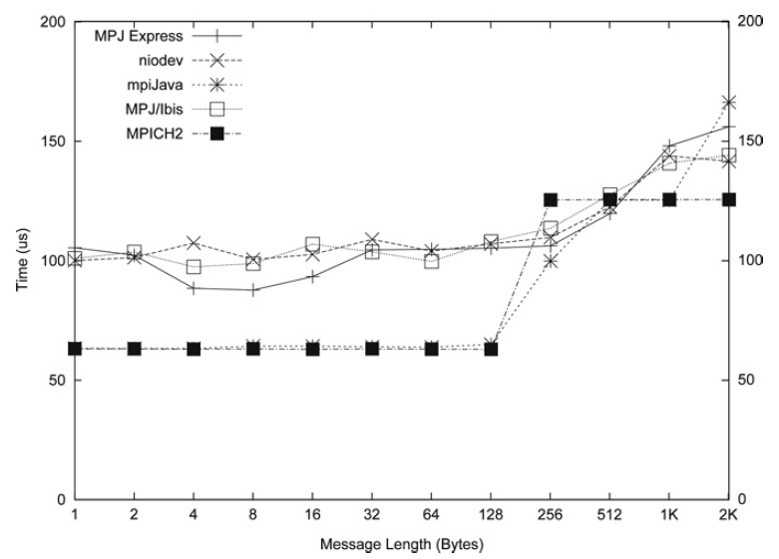
Latency Comparison

Slide 20
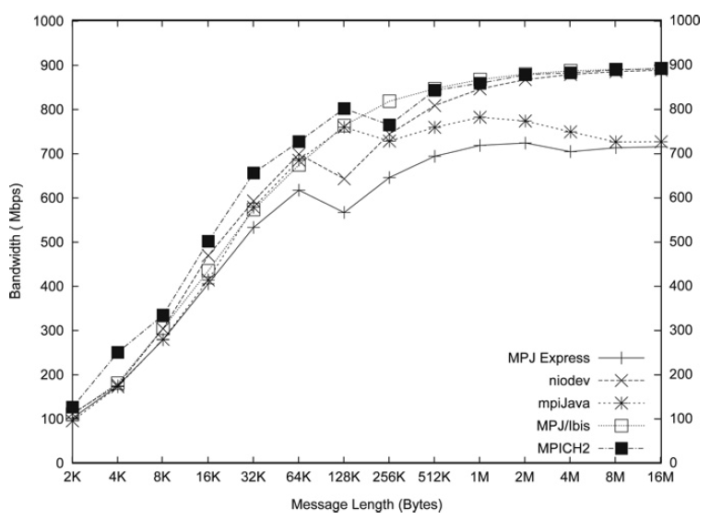
Throughput Comparison

Slide 21
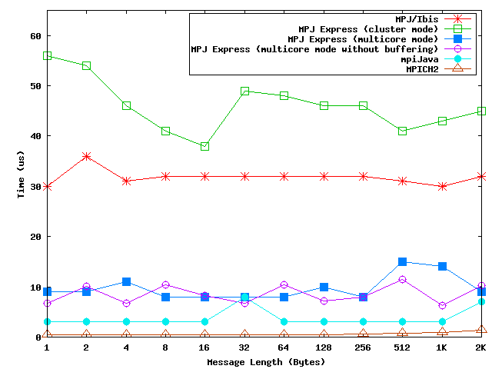
Latency Comparison on a multicore machine

Slide 22
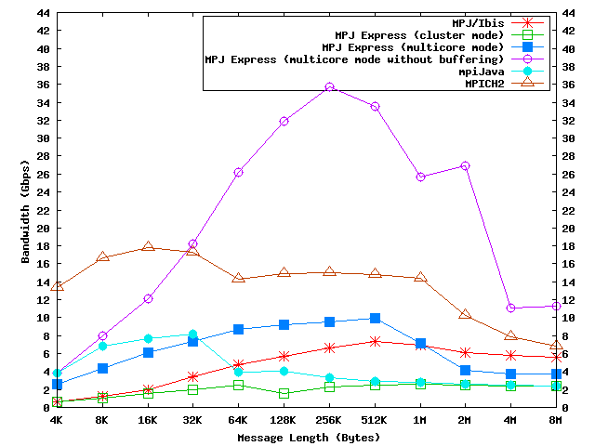
Throughput Comparison on a multicore machine

Slide 23
Collective communications
Provided as a convenience for application developers:
Save significant development time
Efficient algorithms may be used
Stable (tested)
Built on top of point-to-point communications

Slide 24
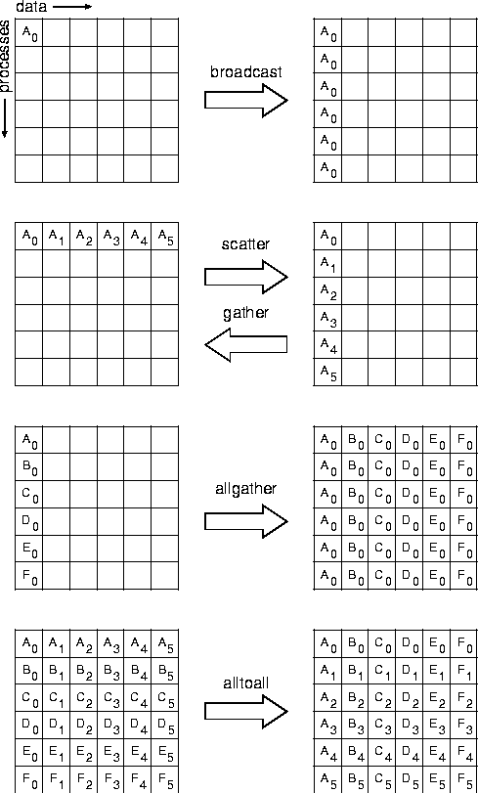
Image from MPI standard doc

Slide 25
Reduce collective operations
Processes
MPI.PROD
MPI.SUM
MPI.MIN
MPI.MAX
MPI.LAND
MPI.BAND
MPI.LOR
MPI.BOR
MPI.LXOR
MPI.BXOR
MPI.MINLOC
MPI.MAXLOC

Slide 26
Documentation: Send() method

Slide 27
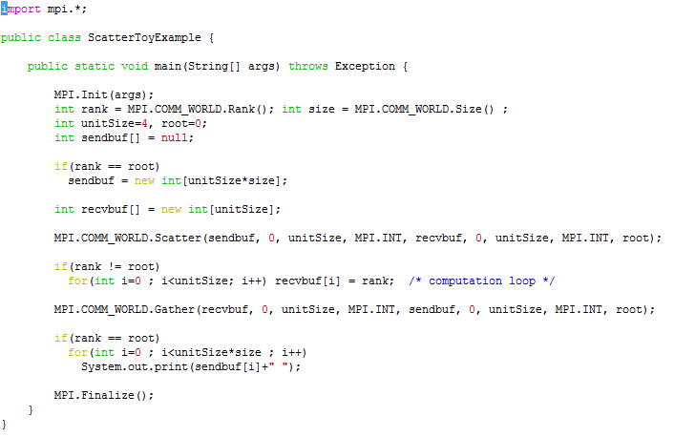
Toy Example with Collectives

